Slide 1

Exploratory Data Analysis: Facebook Data
Mitchell Keomoungkhoune
SSIE 643 Advanced Engineering Analytics Final Project
Dr. Changqing Cheng

Slide 2
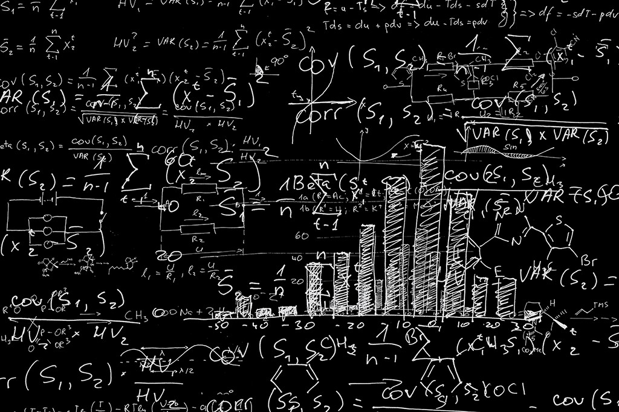
Presentation Agenda
1. Background
4. Results
2. Facebook Dataset
5. Conclusions
3. Methodology

Slide 3


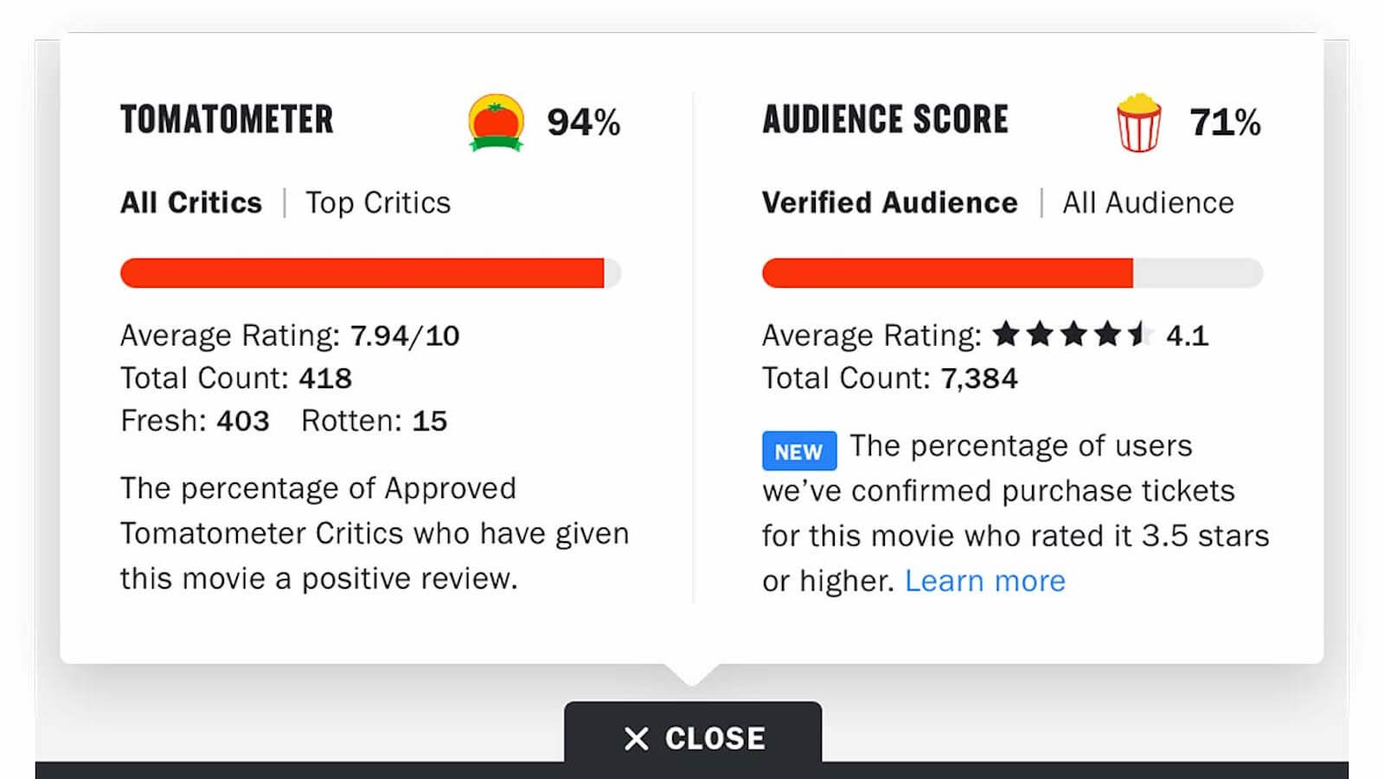




EDA Analogy : Movie Selection
Exploratory Data Analysis

Slide 4
What is Exploratory Data Analysis?
EDA (Exploratory Data Analysis) refers to critical process of performing initial investigations on data to:
Discover patterns
Identify anomalies
Hypothesis testing
Check assumptions
Summary statistics
Graphical and data visualization methods
Boxplots, histograms, scatter plots, bar charts, etc.

Slide 5
Phases of EDA
Phase 1
Problem Statement: Facebook Data
Phase 2
Data pre-profiling
Summarization and check for missing values
Phase 3
Data pre-processing
Data cleaning, data manipulation, etc.
Phase 4
Data visualization
Bar graphs, scatter plots, box plots, etc.
Phase 5
Summarize results
Interpret findings

Slide 6
Examples of EDA Applications
Data Scientists
Clinical Studies
Retail Overview

Slide 7


Facebook Dataset
Data on user information and usage/habits
Dataset from Kaggle
Large dataset - 99003 observations with 15 different variables
Sourced from 2013

Slide 8
Facebook Dataset Sample
userid | age | dob_day | dob_year | dob_month | gender | tenure | friend_count | friendships_initiated | likes | likes_received | mobile_likes | mobile_likes_received | www_likes | www_likes_received
2094382 | 14 | 19 | 1999 | 11 | male | 266 | 0 | 0 | 0 | 0 | 0 | 0 | 0 | 0
1192601 | 14 | 2 | 1999 | 11 | female | 6 | 0 | 0 | 0 | 0 | 0 | 0 | 0 | 0
2083884 | 14 | 16 | 1999 | 11 | male | 13 | 0 | 0 | 0 | 0 | 0 | 0 | 0 | 0
1203168 | 14 | 25 | 1999 | 12 | female | 93 | 0 | 0 | 0 | 0 | 0 | 0 | 0 | 0
1733186 | 14 | 4 | 1999 | 12 | male | 82 | 0 | 0 | 0 | 0 | 0 | 0 | 0 | 0
1524765 | 14 | 1 | 1999 | 12 | male | 15 | 0 | 0 | 0 | 0 | 0 | 0 | 0 | 0
1136133 | 13 | 14 | 2000 | 1 | male | 12 | 0 | 0 | 0 | 0 | 0 | 0 | 0 | 0
1680361 | 13 | 4 | 2000 | 1 | female | 0 | 0 | 0 | 0 | 0 | 0 | 0 | 0 | 0
1365174 | 13 | 1 | 2000 | 1 | male | 81 | 0 | 0 | 0 | 0 | 0 | 0 | 0 | 0
1712567 | 13 | 2 | 2000 | 2 | male | 171 | 0 | 0 | 0 | 0 | 0 | 0 | 0 | 0
1612453 | 13 | 22 | 2000 | 2 | male | 98 | 0 | 0 | 0 | 0 | 0 | 0 | 0 | 0
2104073 | 13 | 1 | 2000 | 2 | male | 55 | 0 | 0 | 0 | 0 | 0 | 0 | 0 | 0
1918584 | 13 | 5 | 2000 | 3 | male | 106 | 0 | 0 | 0 | 0 | 0 | 0 | 0 | 0
1704433 | 13 | 21 | 2000 | 3 | male | 61 | 0 | 0 | 0 | 0 | 0 | 0 | 0 | 0
1932519 | 13 | 28 | 2000 | 3 | female | 0 | 0 | 0 | 0 | 0 | 0 | 0 | 0 | 0
1751722 | 13 | 7 | 2000 | 4 | female | 16 | 0 | 0 | 0 | 0 | 0 | 0 | 0 | 0
1470850 | 13 | 30 | 2000 | 5 | female | 34 | 0 | 0 | 0 | 0 | 0 | 0 | 0 | 0
1001768 | 13 | 23 | 2000 | 5 | female | 25 | 0 | 0 | 0 | 0 | 0 | 0 | 0 | 0
1537661 | 13 | 16 | 2000 | 5 | female | 4 | 0 | 0 | 0 | 0 | 0 | 0 | 0 | 0
1020296 | 13 | 13 | 2000 | 8 | male | 9 | 0 | 0 | 0 | 0 | 0 | 0 | 0 | 0
1472643 | 13 | 13 | 2000 | 9 | female | 9 | 0 | 0 | 0 | 0 | 0 | 0 | 0 | 0
2041297 | 13 | 22 | 2000 | 9 | female | 10 | 0 | 0 | 0 | 0 | 0 | 0 | 0 | 0
1514978 | 13 | 2 | 2000 | 9 | male | 0 | 0 | 0 | 0 | 0 | 0 | 0 | 0 | 0
1708962 | 15 | 17 | 1998 | 11 | male | 98 | 0 | 0 | 0 | 0 | 0 | 0 | 0 | 0
1098955 | 15 | 3 | 1998 | 11 | male | 100 | 0 | 0 | 0 | 0 | 0 | 0 | 0 | 0
1001243 | 15 | 11 | 1998 | 11 | male | 28 | 0 | 0 | 0 | 0 | 0 | 0 | 0 | 0
2113084 | 15 | 24 | 1998 | 11 | male | 52 | 0 | 0 | 0 | 0 | 0 | 0 | 0 | 0
2163454 | 15 | 15 | 1998 | 11 | male | 0 | 0 | 0 | 0 | 0 | 0 | 0 | 0 | 0
1670750 | 15 | 28 | 1998 | 12 | male | 24 | 0 | 0 | 0 | 0 | 0 | 0 | 0 | 0
1041376 | 15 | 11 | 1998 | 12 | male | 41 | 0 | 0 | 0 | 0 | 0 | 0 | 0 | 0
1762274 | 15 | 10 | 1998 | 12 | male | 17 | 0 | 0 | 0 | 0 | 0 | 0 | 0 | 0
1903650 | 14 | 16 | 1999 | 1 | male | 165 | 0 | 0 | 0 | 0 | 0 | 0 | 0 | 0
2087235 | 14 | 14 | 1999 | 1 | male | 15 | 0 | 0 | 0 | 0 | 0 | 0 | 0 | 0
1871735 | 14 | 1 | 1999 | 1 | female | 578 | 0 | 0 | 0 | 0 | 0 | 0 | 0 | 0
1459785 | 14 | 1 | 1999 | 1 | male | 478 | 0 | 0 | 0 | 0 | 0 | 0 | 0 | 0
1215208 | 14 | 1 | 1999 | 1 | male | 170 | 0 | 0 | 0 | 0 | 0 | 0 | 0 | 0

Slide 9
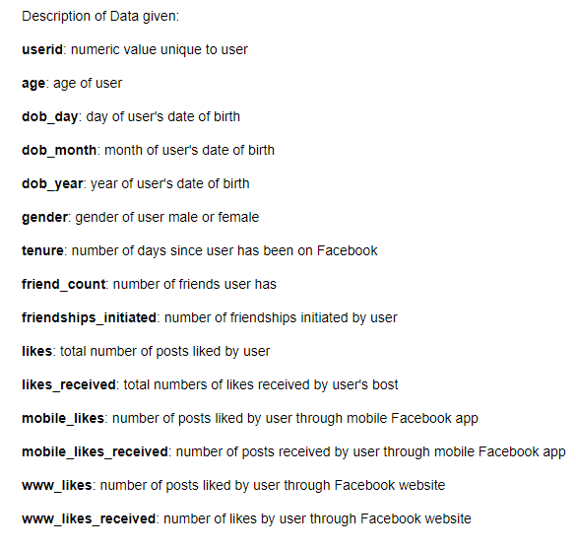
Description of Variables: Facebook Data
dob_day: day of user’s date of birth
tenure: number of days since user has been on Facebook
likes: total number of posts like by user

Slide 10


Objective
Analyze Facebook data
Identify patterns and trends
Use graphical and visualization tools
Summarize findings and interpret results

Slide 11
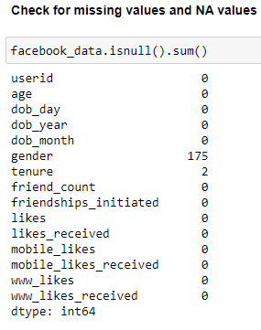
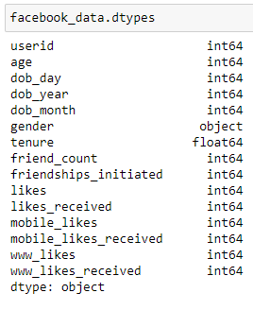
Data Pre-Profiling
Check for missing values and null values:
175 missing values for gender
2 missing values for tenure
Check data types:
Gender datatype: object
Tenure datatype: float

Slide 12
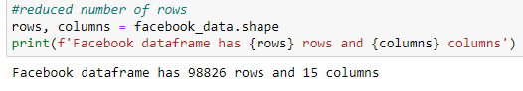
Data Pre-Processing
Drops rows in gender with missing values
Fill “NA” values for tenure with mean value

Slide 13
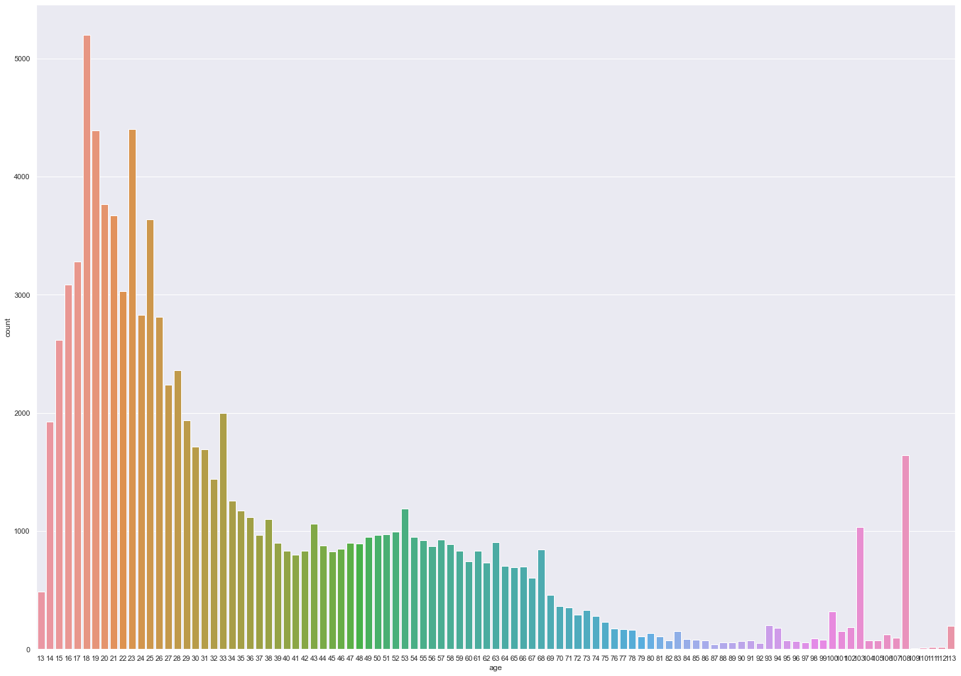
Age analysis:
Ages ≈ 15-33 makes up majority of Facebook users
Teenagers and young adults

Slide 14
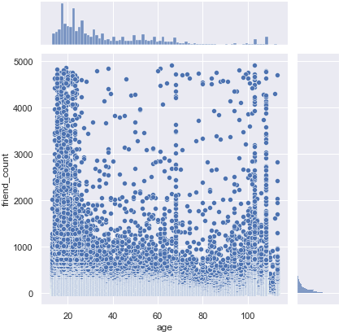
Age and friend count
Higher friend counts for teenagers and young adults

Slide 15
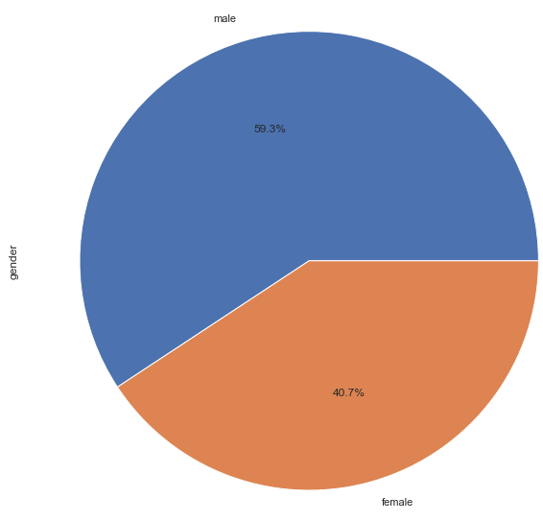
More male users than female users
Male = 59.3 %
Female = 40.7 %

Slide 16
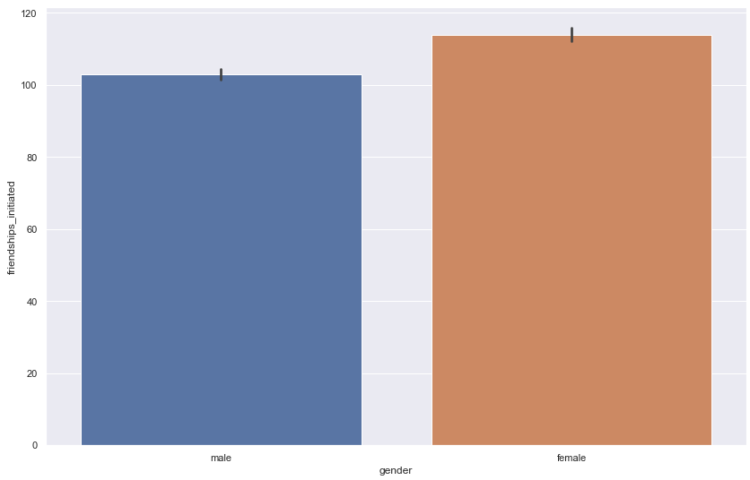
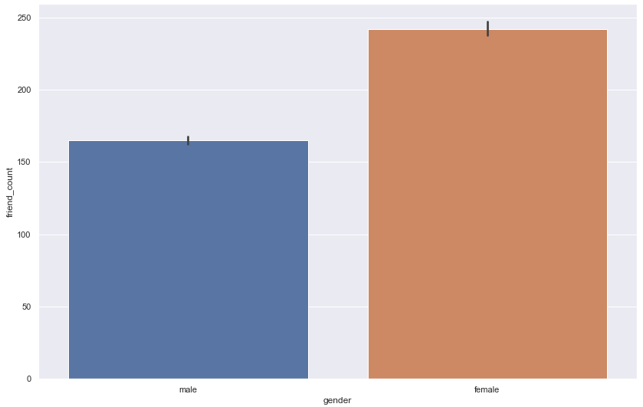
Gender in relation to friend count and initiated friendships
Females' larger friend count than males
Females’ have more initiated friendships than males

Slide 17
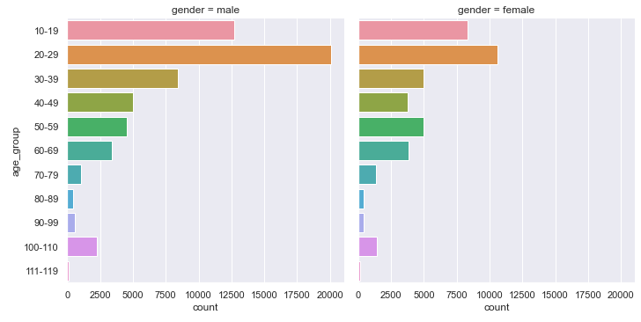
Gender and age group
Most users fall in range 20-29 years
Generally, more male users than female users

Slide 18
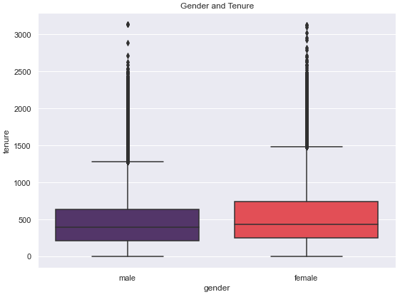
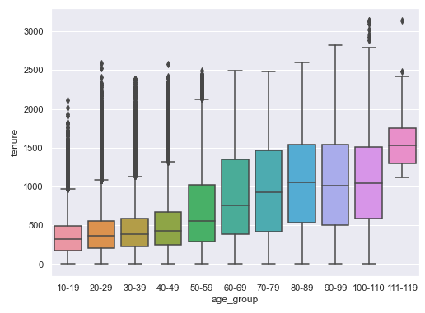
Tenure relation to gender and age groups
Tenure is lower for males
Tenure is lower for younger ages
Tenure generally increases as age increases

Slide 19
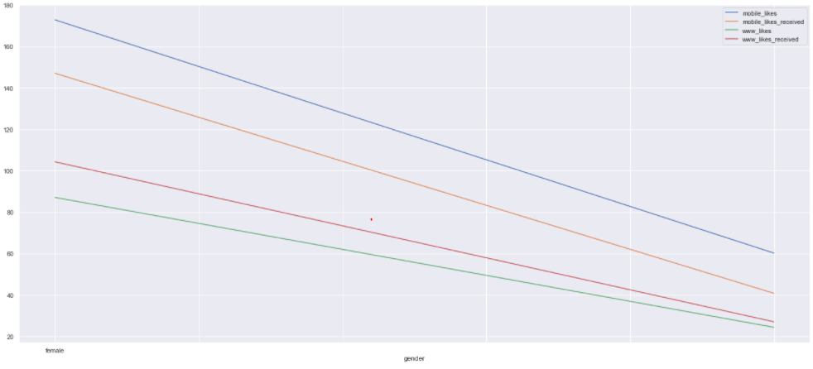
More likes and likes received in mobile app
Likes and likes received more prominent with female users

Slide 20
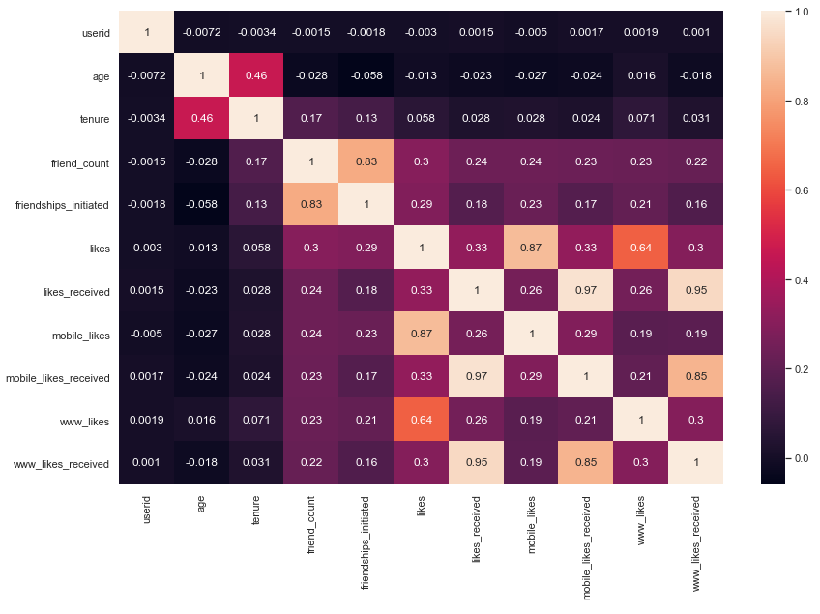
Heat map – correlation between variables of dataset
High correlation:
Friend count and friendships initiated
Likes received and mobile likes received

Slide 21
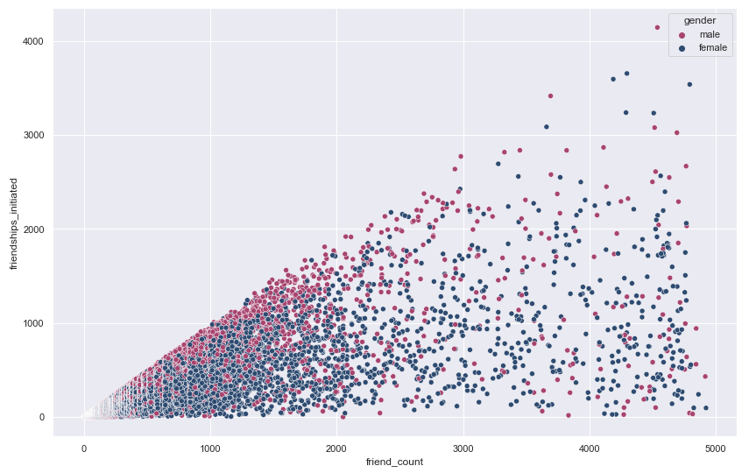
High positive correlation for friend count and friendships initiated

Slide 22
Summary of Results
Age of most users fall in 20-29 range
More male users (59.3 %) than female users (40.7 %)
Females have larger friend count and initiated friendships
Tenure generally lower for males and younger age groups
More likes and likes received in mobile app (63.67 %) than Facebook website (36.33 %)
High correlation between friend count and initiated friendships

Slide 23
Conclusions
Users within ages 20-29 are most prone to use Facebook
There are more male users than female users on Facebook
Females have more Facebook friends and initiated friendships
Users typically are absent from Facebook longer as age increases
Facebook mobile app is more popular than Facebook website

Slide 24
References
https://www.simplilearn.com/exploratory-data-analysis-article
https://www.ibm.com/cloud/learn/exploratory-data-analysis#:~:text=discovery%20process%20today.-,Why%20is%20exploratory%20data%20analysis%20important%20in%20data%20science%3F,interesting%20relations%20among%20the%20variables.
https://towardsdatascience.com/exploratory-data-analysis-8fc1cb20fd15
https://blog.jovian.ai/pseudo-facebook-data-analysis-36383ec51507
https://www.kaggle.com/pseudo_facebook

Slide 25
Thank you! Are there any questions?

